Slide 2
Storage & Databases
APP Course
Notes:
Ask some questions:
How many have used a database?
Have any of you done some database modeling and/or implemented a database?
How many have used Microsoft SQL Server or Redis Cache?

Slide 3
Agenda
Intro to databases
Data modelling
Structured Query language (SQL)
Performance
SQL Injection
Workshop

Slide 4
Intro: Why do we need databases?
«Databases are essential for organizing, managing, securing, and efficiently retrieving data, making them a fundamental component of nearly every software system and data-driven organization. They enable data-driven decision-making, support business processes, and ensure data is available, reliable, and secure”
“Databases are fundamental to modern computing environments, supporting a wide range of applications from simple websites to complex analytical systems, ensuring that data is organized, secure, accessible, and useful.”
Notes:
The 1960s saw the emergence of the first navigational database systems. These systems, such as IBM's Information Management System (IMS) and Charles Bachman's Integrated Data Store (IDS), were hierarchical and network databases

Slide 5
Intro: Types of databases
process
Relation databases (RDBMS)
Structured data
Tables, rows, columns
Relationships between tables
ACID (Atomicity, Consistency, Isolation, Durability) properties, which ensure that database transactions are reliable, consistent, and maintain data integrity
Supports Structured Query Language (SQL)
Non-relation (NoSQL) databases
Unstructured, semi-structured & structured data
Document stores (json/bson)
Key-value stores (key-value pairs)
Object stores (files and media)
Varying degree of support for transactions
No standard query language, often APIs or SQL-like query language
Notes:
RDMS – Rational Database Management System
Edgar F. Codd, an English computer scientist working at IBM, in a seminal 1970 paper titled "A Relational Model of Data for Large Shared Data Banks”

Slide 6
Intro: Relation databases vs non-relation (NoSQL) databases
GitHub Actions
Choose a relation database when:
Data structure is well defined
ACID is a requirement
Need to run complex queries
Extra level of security
Small to medium sized database
Legacy systems
Choose a NoSQL database when:
Semi-structured or unstructured data
Massive amounts of data
High availability & low latency
Simplify development complexity (less need for ORM)
More cost-effective at large scale
Notes:
ORM – Object Rational Mapping: Entity Framework , Dapper, Hibernate, Django

Slide 7
Intro: Most used databases
Pull requests
Relation databases
Microsoft SQL Server
Oracle Databases
SQLite
MySQL
PostgreSQL
No-SQL databases
MongoDB (Document database)
Amazon DynamoDB (Key value store)
Redis (Key-value store)
Azure Object Storage (Object store)
Notes:
Who have used any of these databases?

Slide 8
Data modelling
GitHub Actions
Several key principles should be followed to ensure the database is structured efficiently, scalable, and capable of supporting the applications that will interact with it:
Normalization – Minimize redundancy and dependency (1NF, 2NF, 3NF, Boyce-Codd) - Theory
Data integrity
Entity (primary key, uniquely identifies a row)
Reference (foreign key ensures that referenced rows exists)
Domain (the columns have a correct data type, format and valid values)
Keys - Primary , foreign, unique, (composite)
Performance – indexes
Entity-Relationship (ER) diagrams
Notes:
- Codd in Boyce-Codd is the same Edgar F. Codd that wrote the 1970 paper titled "A Relational Model of Data for Large Shared Data Banks”

Slide 9

Entity-Relationship (ER) diagrams
Environments
“ER diagrams are used in database design and systems analysis because they provide a graphical way to model data structures and their relationships in a clear and systematic manner”
Database design
Visual Representation
Communication tool
Documentation
Notes:
You may have heard about sequence diagrams, flow chars and other diagrams
Any of you ever heard of/used ER-diagrams?
Is it really as simple as the example ER diagram shows?
What if we need to know all artist that have performed a certain song?

Slide 10
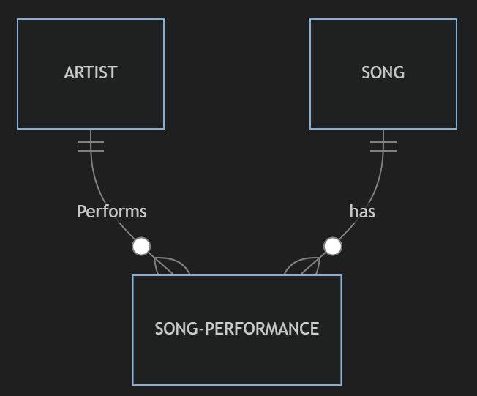
Entity-Relationship (ER) diagrams
Environments
One song can be performed by different artists
We need a “link” table “song-performance”
Keys:
Artist: artist_id (primary key)
Song: song_id (primary key)
Song-performance:
song_performancee_Id (primary key)
artist_id (foreign key)
song_id (foreign key)
artist_id + song_id (unique index)
Notes:
But what if we want to know the different performances the same artist have done of the same song?
Maybe we are modelling a concert tracking system?
How would that ER diagram look like?
That is something that we are going to look into in the workshop ;-)

Slide 11
Important objects in a relation databases
GitHub Actions
Database
Table
Record/row
Column – Datatypes
Key –Primary, foreign, candidate, composite
Index – For read/select performance - unique, non-unique
View – A virtual table based on the result set of a SQL statement
Functions – Built in functions and user defined functions
Stored procedures – Prepared SQL code stored in the database for reuse
Schema – Logically group of database objects
Notes:
- NB! Indexes makes read/select performance, but degrades write performance (insert, update, delete)
- Schemas is often used to divide a database into sub parts/domains but also for security reasons

Slide 12
Structured Query Language (SQL)
GitHub Actions
A standardized language since ‘86/’87
But the different databases that support the SQL standard have their own proprietary extension to the standard
A language for accessing and modifying data
What can SQL do?
– Get, create and manipulate all the different database objects
Create a new database
Create new tables
Insert records into tables
Update records in a table
Delete records in a table
Execute queries
+++
Notes:
Standardized:
- American National Standards Institute (ANSI) in 1986
- International Organization for Standardization (ISO) in 1987

Slide 13
Structured Query Language (SQL)
GitHub Actions
All SQL versions support the following commands:
SELECT – Get records from tables
Example: SELECT * FROM [DBO].[Student];
INSERT INTO – Insert records into tables
Example: INSERT INTO [DBO].[Student] (FirstName, LastName) VALUES (‘Sam’, ‘Johnson’) ;
WHERE – Filter on what records to get or modify
Example : SELECT * FROM [DBO].[Student] WHERE [LastName] = ‘Johnson’;
UPDATE – Updates records
Example : UPDATE [DBO].[Student] SET [FirstName] = ‘Samuel’ WHERE [LastName] = ‘Johnson’;
DELETE – Deletes records
Example DELETE FROM [DBO].[Student] WHERE [LastName] = ‘Johnson’;
Notes:
- Anyone used LINQ in C#?
- Good tutorial: https://www.w3schools.com/sql/default.asp

Slide 14
Structured Query Language (SQL)
GitHub Actions
Joining tables with aliases - Join the table [Class] with the table [Student] with primary key [ClassId] in the [Class] table and the foreign key [ClassId] in the [Student] table:
SELECT c.[ClassName], s.* FROM [DBO].[Class] c JOIN [DBO].[Student] s ON c.[ClassId] = s.[ClassId]
Sorting records from a SQL query - Sort by [Lastname] ascending, then by [FirstName] descending:
SELECT * FROM [DBO].[Student] ORDER BY [LastName], [FirstName] DESC
Grouping records - Number of students with the same last name:
SELECT Count(*) NumberOfStudents, [LastName] FROM [DBO].[Student] GROUP BY [LastName]
Functions
- Built in functions – Different functions in the different databases:
-Count() , Substring(), Convert(), DateDiff(), DateAdd(), GetDate(), +++
- You can also create your own
s.* …. FROM [DBO].[Class] c

Slide 15
Performance - Indexes
GitHub Actions
When to use:
Queries that are slow due to selecting, grouping or filtering on columns that are not primary keys
Increases read performance (SELECT) & Decreases write performance (INSERT, UPDATE, DELETE)
Indexes:
- created for one or multiple columns
- unique or non-unique
- must have a name
- Clustered (max one pr table) or non-clustered
How do they work?
- Ex. Balanced trees, B+ trees and hashes
- Leaf node either contain the data or a reference to the data
Example (syntax varies for different databases):
CREATE INDEX idx_lastName ON [DBO].[Student] ([LastName])

Slide 16
Performance - Indexes
GitHub Actions
Clustered
Usually the primary key
Is sorted
Faster than a non clustered
Uses less memory to execute
Allows to save the data in the leaf node
Only one allowed pr. table
Non clustered
Collects the data at one place and records at another place
Slower than a clustered
Needs more memory to execute
Never stores data at leaf node
Can have multiple pr. table

Slide 17
Performance – Index scan vs Index seek
GitHub Actions
Scan
- Searches the entire index to find all the rows than meet the search condition (the WHERE clause, but also the SELECT clause)
- Consumes more CPU and I/O resources
+ More acceptable or preferred for small tables or in cases where most of the rows must be examined
Seek
+ Uses the index to find the rows that meet the search condition
+ Consumes less CPU and I/O resource
- Remember that indexes comes with a cost for write operation like INSERT, DELETE & UPDATE
➔ In general, we want to achieve index seek over index scan

Slide 18
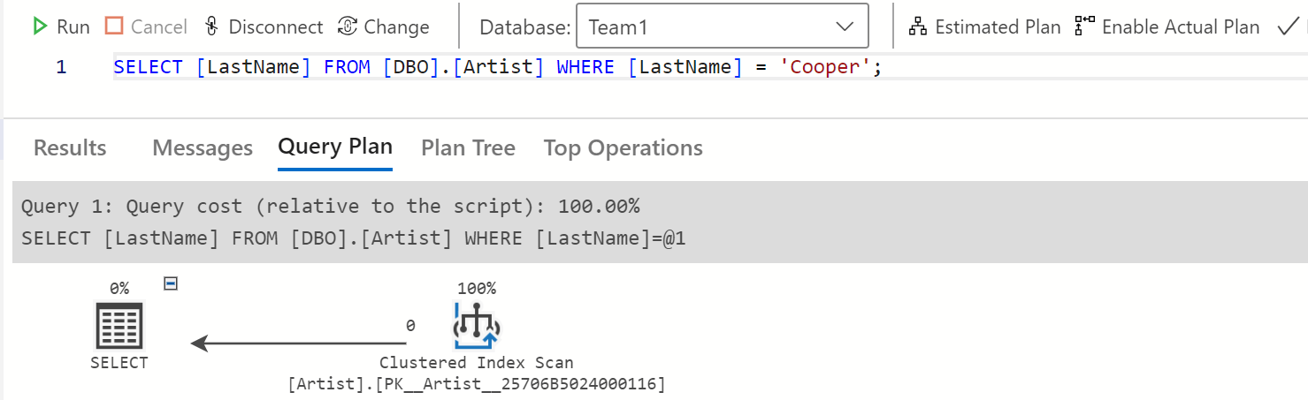
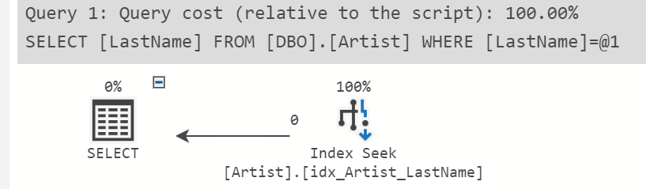
Azure Data Studio – Actual Plan
GitHub Actions
Can be used to analyze queries and find if the query or database tables are optimal
😢
😍
Notes:
Estimated plan: Uses statistics stored in the database to do a best guess of how the query would be executed
Actual plan: Shows how the query was actually executed

Slide 19
Security – SQL Injection
GitHub Actions
From Owasp: https://owasp.org/www-community/attacks/SQL_Injection
“A SQL injection attack consists of insertion or “injection” of a SQL query via the input data from the client to the application. A successful SQL injection exploit can read sensitive data from the database, modify database data (Insert/Update/Delete), execute administration operations on the database (such as shutdown the DBMS), recover the content of a given file present on the DBMS file system and in some cases issue commands to the operating system. SQL injection attacks are a type of injection attack, in which SQL commands are injected into data-plane input in order to affect the execution of predefined SQL commands.”
Example:
Code concatenates parameter from API with rest of statement:
string sqlStatement = “SELECT * FROM [DBO].[Artist] WHERE [LastName] = ‘” + lastName + “’”;
But what if the parameter “lastName” contains the following?
“hacker';SELECT * FROM sys.Tables’;SELECT ‘”
Result in the valid query:
“SELECT * FROM [DBO].[Artist] WHERE [LastName] = 'hacker';SELECT * FROM sys.Tables;SELECT ‘’”

Slide 20
Security – SQL Injection
GitHub Actions
How to avoid:
Use frameworks for executing queries
Example in C# using the “SqlCommand” class with a parameterized query and adding parameters to the SqlCommand before executing the query:
var sqlCommand = new SqlCommand();
var sql = "SELECT * FROM TBL_USER_MASTER WHERE USER_NAME = @parameter"; sqlCommand.CommandText = sql;
// Add the Parameter
sqlCommand.Parameters.AddWithValue("parameter", "sebastian");
// Execute the query and do something with it
var reader = sqlCommand.ExecuteReader();

Slide 21
We are done Keep on learning!

